Slide 1
CS61C: Great Ideas in Computer Architecture (aka Machine Structures)
Lecture 9: RISC-V Part 2: Data Transfer
Instructors: Lisa Yan, Justin Yokota

Slide 2
Agenda
Main Memory
Data Transfer Instructions
C code examples

Slide 3
Agenda
Main Memory
Data Transfer Instructions
C code examples

Slide 4
RV32 So Far…
Addition/subtraction
add rd, rs1, rs2
rd = rs1 + rs2
sub rd, rs1, rs2
rd = rs1 - rs2
Where rd, rs1, rs2 are registers (x0 - x31)
Add immediate
addi rd, rs1, imm
rd = rs1 + imm
(New) Load immediate
li rd, imm
rd = imm
Not a "real" instruction, because we can use existing instructions to do the same thing:
li rd, 5 -> addi rd, x0, 5
However, this is common enough that RISC-V includes this as a pseudoinstruction. Pseudoinstructions get replaced with their real instruction counterpart by the assembler.

Slide 5
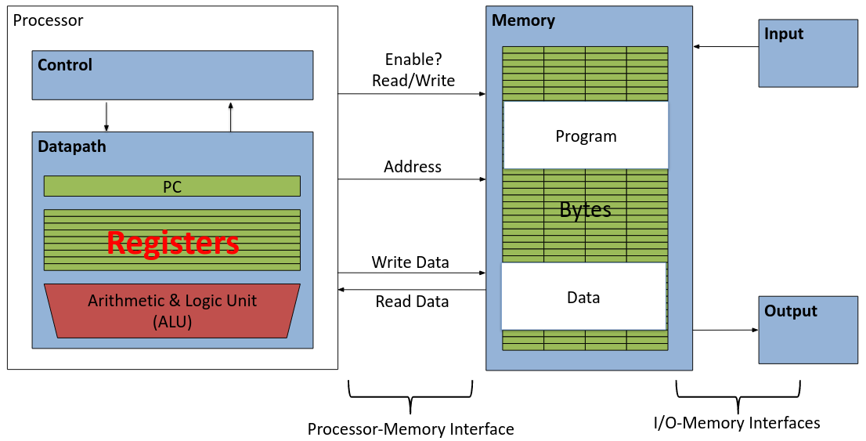
Data Transfer: Load from and Store to memory
Much larger place to hold values, but slower than registers!
Very fast, but limited space to hold values!

Slide 6
Review: How memory works
On a 32-bit system, main memory contains 2³² bytes. Every 32-bit number acts as the address of one byte.
4 bytes together make a word. In order to store a word in memory, we cut the word up into 4 bytes, then store those bytes in consecutive addresses. In order to read a word, we read 4 consecutive addresses, then stitch those bytes back together
RISC-V uses little-endian to store data: The least significant byte gets stored at the lowest address.
By convention we say that a word is stored at its lowest address
Ex. The word stored at address 0x1000 is composed of the bytes 0x1000, 0x1001, 0x1002, and 0x1003

Slide 7
Agenda
Main Memory
Data Transfer Instructions
C code examples

Slide 8
Load Word
Load Word syntax:
lw rd imm(rs1)
Means: Compute imm+rs1, then load the 4 bytes at that address into rd
Byte (0x) | EF | BE | AD | DE | 43 | 53 | 36 | 31 | 43 | 20 | 52 | 49 | 53 | 42 | 56 | 00
Address (0x) | 100 | 101 | 102 | 103 | 104 | 105 | 106 | 107 | 108 | 109 | 10A | 10B | 10C | 10D | 10E | 10F

Slide 9
Load Word
Example: lw x10 12(x5) if x5 is 0x100
0x100+12 = 0x10C
Bytes at 0x10C-0x10F are 0x53, 0x42, 0x56, 0x00
Since RISC-V is little-endian, this is the 32-bit value 0x0056 4253
So register x10 will now store 0x0056 4253
Byte (0x) | EF | BE | AD | DE | 43 | 53 | 36 | 31 | 43 | 20 | 52 | 49 | 53 | 42 | 56 | 00
Address (0x) | 100 | 101 | 102 | 103 | 104 | 105 | 106 | 107 | 108 | 109 | 10A | 10B | 10C | 10D | 10E | 10F

Slide 10
Store Word
Store Word syntax:
sw rs2 imm(rs1)
Means: Compute imm+rs1, then store the 4 bytes of rs2 into that address.
Byte (0x) | EF | BE | AD | DE | 43 | 53 | 36 | 31 | 43 | 20 | 52 | 49 | 53 | 42 | 56 | 00
Address (0x) | 100 | 101 | 102 | 103 | 104 | 105 | 106 | 107 | 108 | 109 | 10A | 10B | 10C | 10D | 10E | 10F

Slide 11
Store Word
Example: sw x10 0(x5) if x5 is 0x100, x10 is 0x1234 5678
0x100+0 = 0x100
Since RISC-V is little-endian, the 32-bit value 0x1234 5678 gets split into bytes 0x78 0x56 0x34 0x12
So the bytes in memory 0x100, 0x101, 0x102, and 0x103 get set to 0x78, 0x56, x34, and 0x12, respectively.
Byte (0x) | 78 | 56 | 34 | 12 | 43 | 53 | 36 | 31 | 43 | 20 | 52 | 49 | 53 | 42 | 56 | 00
Address (0x) | 100 | 101 | 102 | 103 | 104 | 105 | 106 | 107 | 108 | 109 | 10A | 10B | 10C | 10D | 10E | 10F

Slide 12
Loading and Storing Bytes
In addition to word data transfers (lw, sw), RISC-V has byte data transfers:
lb rd imm(rs1)
sb rs2 imm(rs1)
Load and store one byte instead of a full word
Problem: If registers contain 4 bytes, how do we load/store only 1 byte?
Byte (0x) | EF | BE | AD | DE | 43 | 53 | 36 | 31 | 43 | 20 | 52 | 49 | 53 | 42 | 56 | 00
Address (0x) | 100 | 101 | 102 | 103 | 104 | 105 | 106 | 107 | 108 | 109 | 10A | 10B | 10C | 10D | 10E | 10F

Slide 13
Store Byte
Example: sb x10 0(x5) if x5 is 0x100, x10 is 0x1234 5678
For sb, we store the least significant byte.
In the above example, 0x78 is the LSB.
So x100 gets set to 0x78
Byte (0x) | 78 | BE | AD | DE | 43 | 53 | 36 | 31 | 43 | 20 | 52 | 49 | 53 | 42 | 56 | 00
Address (0x) | 100 | 101 | 102 | 103 | 104 | 105 | 106 | 107 | 108 | 109 | 10A | 10B | 10C | 10D | 10E | 10F

Slide 14
Load Byte
Example: lb x10 0(x5) if x5 is 0x100
For lb, we extend the numeric value to a full 32 bits.
In the above example, we load the number 0xEF. What 32-bit number has the same numeric value as 0xEF?
Answer: It depends on your representation scheme
Byte (0x) | EF | BE | AD | DE | 43 | 53 | 36 | 31 | 43 | 20 | 52 | 49 | 53 | 42 | 56 | 00
Address (0x) | 100 | 101 | 102 | 103 | 104 | 105 | 106 | 107 | 108 | 109 | 10A | 10B | 10C | 10D | 10E | 10F

Slide 15
Sign- and Zero-extending
There are two main representation schemes used: unsigned numbers, and 2's complement
For unsigned numbers: 8-bit 0xEF = 239. 239 -> 32 bits is 0x000000EF. General rule: Fill the top bits with 0s (Zero-extension).
For signed numbers: 8-bit 0xEF = -17. -17 -> 32 bits is 0xFFFF FFEF.
General rule: Fill the top bits with the most significant bit of the number (Sign-extension).
Typo adjusted (-16 → -17)
See Ed

Slide 16
Loading and Storing Bytes
In addition to word data transfers (lw, sw), RISC-V has byte data transfers:
lb rd imm(rs1)
lb rd imm(rs1) -> sign extend the byte
lbu rd imm(rs1) -> zero extend the byte
sb rs2 imm(rs1) -> store least significant byte only
Load and store one byte instead of a full word
Byte (0x) | EF | BE | AD | DE | 43 | 53 | 36 | 31 | 43 | 20 | 52 | 49 | 53 | 42 | 56 | 00
Address (0x) | 100 | 101 | 102 | 103 | 104 | 105 | 106 | 107 | 108 | 109 | 10A | 10B | 10C | 10D | 10E | 10F

Slide 17
Example: What is in x12?
li x11,0x93F5
sw x11,0(x5)
lb x12,1(x5)

Slide 18
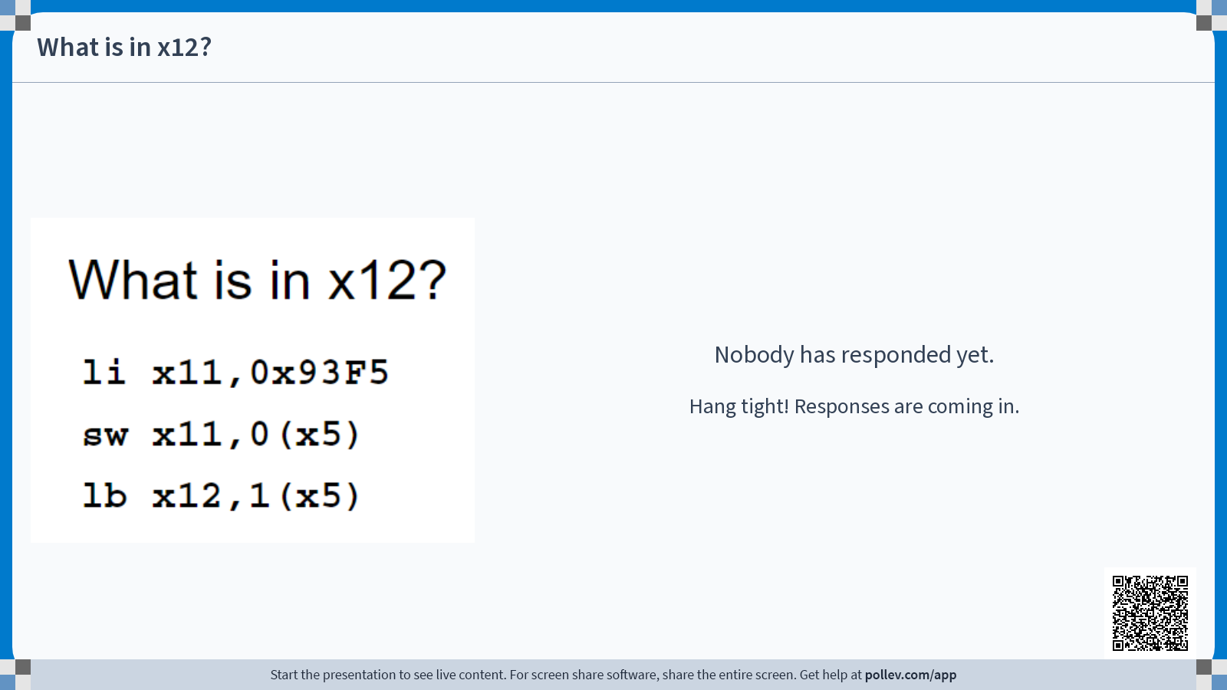

Slide 19
Example: What is in x12?
li x11,0x93F5
sw x11,0(x5)
lb x12,1(x5)
Current Line
Register | Value
x11 | 0x00000000
x12 | 0x00000000
x5 | 0x00000100
Random garbage since data isn't set
Byte (0x) | EF | BE | AD | DE | 43 | 53 | 36 | 31 | 43 | 20 | 52 | 49 | 53 | 42 | 56 | 00
Address (0x) | 100 | 101 | 102 | 103 | 104 | 105 | 106 | 107 | 108 | 109 | 10A | 10B | 10C | 10D | 10E | 10F

Slide 20
Example: What is in x12?
li x11,0x93F5
sw x11,0(x5)
lb x12,1(x5)
Current Line
Register | Value
x11 | 0x000093F5
x12 | 0x00000000
x5 | 0x00000100
Byte (0x) | EF | BE | AD | DE | 43 | 53 | 36 | 31 | 43 | 20 | 52 | 49 | 53 | 42 | 56 | 00
Address (0x) | 100 | 101 | 102 | 103 | 104 | 105 | 106 | 107 | 108 | 109 | 10A | 10B | 10C | 10D | 10E | 10F

Slide 21
Example: What is in x12?
li x11,0x93F5
sw x11,0(x5)
lb x12,1(x5)
Register | Value
x11 | 0x000093F5
x12 | 0x00000000
x5 | 0x00000100
Current Line
Byte (0x) | EF | BE | AD | DE | 43 | 53 | 36 | 31 | 43 | 20 | 52 | 49 | 53 | 42 | 56 | 00
Address (0x) | 100 | 101 | 102 | 103 | 104 | 105 | 106 | 107 | 108 | 109 | 10A | 10B | 10C | 10D | 10E | 10F

Slide 22
Example: What is in x12?
li x11,0x93F5
sw x11,0(x5)
lb x12,1(x5)
Register | Value
x11 | 0x000093F5
x12 | 0x00000000
x5 | 0x00000100
Current Line
Little-Endian order
Byte (0x) | F5 | 93 | 00 | 00 | 43 | 53 | 36 | 31 | 43 | 20 | 52 | 49 | 53 | 42 | 56 | 00
Address (0x) | 100 | 101 | 102 | 103 | 104 | 105 | 106 | 107 | 108 | 109 | 10A | 10B | 10C | 10D | 10E | 10F

Slide 23
Example: What is in x12?
li x11,0x93F5
sw x11,0(x5)
lb x12,1(x5)
Register | Value
x11 | 0x000093F5
x12 | 0x00000000
x5 | 0x00000100
Current Line
Byte (0x) | F5 | 93 | 00 | 00 | 43 | 53 | 36 | 31 | 43 | 20 | 52 | 49 | 53 | 42 | 56 | 00
Address (0x) | 100 | 101 | 102 | 103 | 104 | 105 | 106 | 107 | 108 | 109 | 10A | 10B | 10C | 10D | 10E | 10F

Slide 24
Example: What is in x12?
li x11,0x93F5
sw x11,0(x5)
lb x12,1(x5)
Register | Value
x11 | 0x000093F5
x12 | 0xFFFFFF93
x5 | 0x00000100
Current Line
Sign-extend: Top bit of 0x93 is 1, so fill with 1s
Byte (0x) | F5 | 93 | 00 | 00 | 43 | 53 | 36 | 31 | 43 | 20 | 52 | 49 | 53 | 42 | 56 | 00
Address (0x) | 100 | 101 | 102 | 103 | 104 | 105 | 106 | 107 | 108 | 109 | 10A | 10B | 10C | 10D | 10E | 10F

Slide 25
Agenda
Main Memory
Data Transfer Instructions
C code examples

Slide 26
Converting C code to RISC-V
So far, we've assumed that each variable gets stored in one register. What if we have more than 32 variables? Let's translate a program under the following restrictions:
Only registers x5, x6, and x7 may be modified, and only for intermediate calculations
We'll name them "t0", "t1", and "t2", for "temporary register 0-2"
x2 points to the start of a block of memory that we can use however we want
We'll name x2 "sp", for "stack pointer"

Slide 27
Converting C code to RISC-V
int a = 5; char b[] = "string"; // Array will get stored on stack int c[10]; uint8_t d = b[3]; c[4] = a+d; c[a] = 20;

Slide 28
Converting C code to RISC-V
int a = 5; char b[] = "string"; int c[10]; uint8_t d = b[3]; c[4] = a+d; c[a] = 20;
Step 1: Assign each variable to some offset from sp.
Exact values don't matter as long as we're consistent
a: 0(sp)
b: 4(sp)
c: 12(sp)
d: 52(sp)

Slide 29
Converting C code to RISC-V
int a = 5; char b[] = "string"; int c[10]; uint8_t d = b[3]; c[4] = a+d; c[a] = 20;
a: 0(sp)
b: 4(sp)
c: 12(sp)
d: 52(sp)
li t0 5
sw t0 0(sp)

Slide 30
Converting C code to RISC-V
int a = 5; char b[] = "string"; int c[10]; uint8_t d = b[3]; c[4] = a+d; c[a] = 20;
a: 0(sp)
b: 4(sp)
c: 12(sp)
d: 52(sp)
li t0 0x73
sb t0 4(sp)
li t0 0x74
sb t0 5(sp)
li t0 0x72 sb t0 6(sp) li t0 0x69 sb t0 7(sp) li t0 0x6E sb t0 8(sp) li t0 0x67 sb t0 9(sp)
sb x0 10(sp)

Slide 31
Converting C code to RISC-V (Better Approach)
int a = 5; char b[] = "string"; int c[10]; uint8_t d = b[3]; c[4] = a+d; c[a] = 20;
a: 0(sp)
b: 4(sp)
c: 12(sp)
d: 52(sp)
li t0 0x69727473
sw t0 4(sp)
li t0 0x0000676E
sw t0 8(sp)

Slide 32
Converting C code to RISC-V
int a = 5; char b[] = "string"; int c[10]; uint8_t d = b[3]; c[4] = a+d; c[a] = 20;
a: 0(sp)
b: 4(sp)
c: 12(sp)
d: 52(sp)
Nothing

Slide 33
Converting C code to RISC-V
int a = 5; char b[] = "string"; int c[10]; uint8_t d = b[3]; c[4] = a+d; c[a] = 20;
a: 0(sp)
b: 4(sp)
c: 12(sp)
d: 52(sp)
lb t0 7(sp)
sb t0 52(sp)

Slide 34
Converting C code to RISC-V
int a = 5; char b[] = "string"; int c[10]; uint8_t d = b[3]; c[4] = a+d; c[a] = 20;
a: 0(sp)
b: 4(sp)
c: 12(sp)
d: 52(sp)
lw t0 0(sp)
lbu t1 52(sp)
add t2 t0 t1
sw t2 28(sp)

Slide 35
Converting C code to RISC-V
int a = 5; char b[] = "string"; int c[10]; uint8_t d = b[3]; c[4] = a+d; c[a] = 20;
a: 0(sp)
b: 4(sp)
c: 12(sp)
d: 52(sp)
li t0 20
lw t1 0(sp)
sw t0 t1*4+12(sp)
slli t1 t1 2 #t1*=4
addi t1 t1 12
add t1 t1 sp
sw t0 0(t1)

Slide 36
Converting C code to RISC-V
int a = 5; char b[] = "string"; int c[10]; uint8_t d = b[3]; c[4] = a+d; c[a] = 20;
li t0 5
sw t0 0(sp)
li t0 0x69727473
sw t0 4(sp)
li t0 0x0000676E
sw t0 8(sp)
lb t0 7(sp)
sb t0 52(sp)
lw t0 0(sp)
lbu t1 52(sp)
add t2 t0 t1
sw t2 28(sp)
li t0 20
lw t1 0(sp)
slli t1 t1 2 #t1*=4
addi t1 t1 12
add t1 t1 sp
sw t0 0(t1)

Slide 37
Why we need so many registers
As the previous example showed, it's possible to write RISC-V with only a sp and three temporary registers
Why do we have 32 registers?

Slide 38
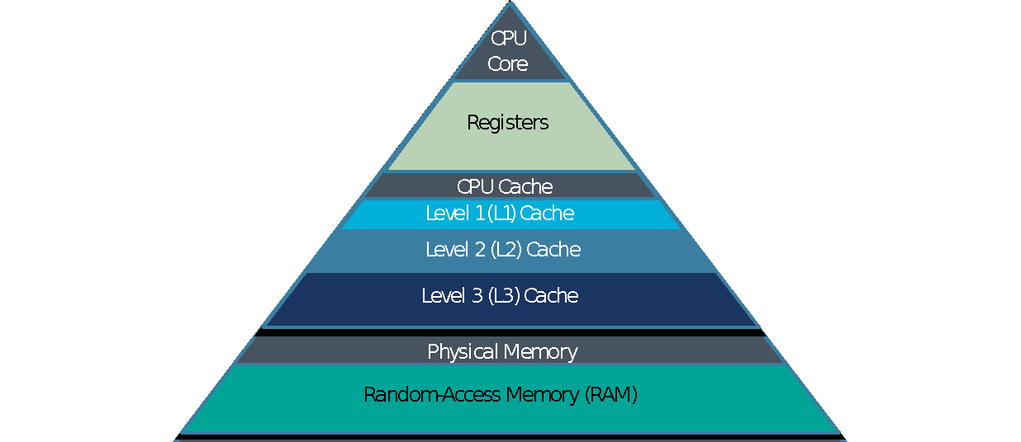
RISC-V Guiding Philosophy
Extremely fast
Extremely expensive Tiny capacity
Fast
Priced reasonably Medium capacity

Slide 39
Speed of Registers vs Memory
Given that
Registers: 32 words (128 Bytes)
Memory (DRAM): Billions of bytes (2 GB to 96 GB on laptop)
and physics dictates…
Smaller is faster
How much faster are registers than DRAM??
About 50-500 times faster! (in terms of latency of one access - tens of ns)
But subsequent words come every few ns

Slide 40


Jim Gray’s Storage Latency Analogy:
How Far Away is the Data?
Jim Gray Turing Award
B.S. Cal 1966
Ph.D. Cal 1969
Sacramento
1.5 hr
100
Memory
1
Registers
My Head
1 min
Notes:
Sacramento image: Sacramento,-California---State-Capitol.jpg (5297×3642) (wikimedia.org)

Slide 41
And in Conclusion…
Memory is byte-addressable, but lw and sw access one word at a time.
A pointer (used by lw and sw) is just a memory address, we can add to it or subtract from it (using offset).
Memory can be used for variables we can't store in registers, but 100x slower than using registers directly
Use loads and stores as infrequently as possible!
New Instructions:
lw, sw, lb, sb, lbu

